Slide 1
Mitosis in Onion Root Tips
Aim
To understand the process and different stages of mitosis and to visualize different phases of mitosis.
An onion root tip is a rapidly growing part of the onion and thus many cells will be in different stages of mitosis. The onion root tips can be prepared and squashed in a way that allows them to be flattened on a microscopic slide
so that the chromosomes of individual cells can be observed easily.
The super coiled chromosomes during different stages of mitosis present in the onion root tip cells can be visualized by treating with DNA specific stains, like Feulgen stain and Acetocarmine stain.

Slide 2
1- Cut the tip 5 to 8 mm from the tip of the freshly sprouted root. Discard the rest of the root.
2- Place the cut tip on a clean microscope slide.
3- Add 2-3 drops of acetocarmine stain to the slide.
4- Warm the slide gently over the alcohol lamp for about one minute. ( Do not allow the slide to get hot to the touch; you don't want to cook either your fingers or the root. Do not let the root dry out).

Slide 3
5- Cover the slide with a cover slip or lens paper.
6- Squash the slide with your thumb using a firm and even pressure. (Avoid squashing with such force that the cover slip breaks or slides).
7-Observe it under a compound microscope in 10x objective. Scan and narrow down to a region containing dividing cells and switch to 40x for a better view.

Slide 4
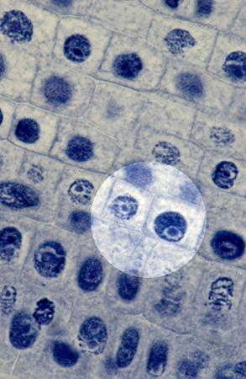
1) Interphase is considered the first and last stage of plant cell division. It is the stage in which the cell is growing in size and replicating its DNA in preparation for division. The nucleus is apparent.

Slide 5
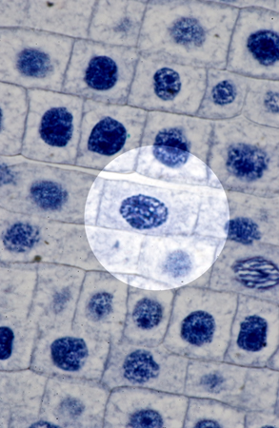
2- Prophase. During Prophase the nuclear envelope starts to break down and all the chromosomes start to coil up in the center of the cell.

Slide 6
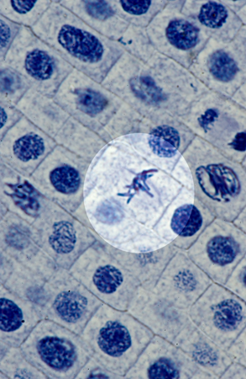
3- Metaphase is the middle stage at which point all the chromosome pairs line up in the center of the cell along spindle fibers that pull to either side of the cell.

Slide 7
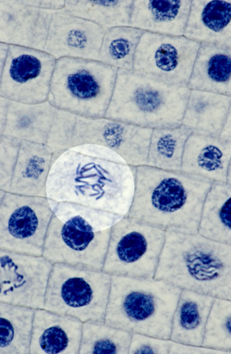
4- Anaphase. The spindle fibers become shorter and pull each chromosome pair apart to the opposite ends of the cell.

Slide 8
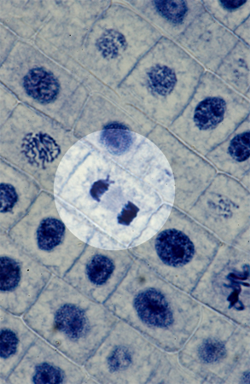
5- Telophase. The final stage of cell replication. The nuclear envelope is reformed. Cytokinesis takes place. A new cell wall is created down the center and two daughter cells are formed.

Slide 9
Thanks

